Slide 1
Cluster Analysis
Notes:
1

Slide 2
Contents
Cluster Analysis: Basic Concepts
Partitioning Methods
Hierarchical Methods
Density-Based Methods
Evaluation of Clustering
Summary
2
2
Notes:
2

Slide 3
What is Cluster Analysis?
Cluster: A collection of data objects
similar (or related) to one another within the same group
dissimilar (or unrelated) to the objects in other groups
Cluster analysis
Finding similarities between data according to the characteristics found in the data and grouping similar data objects into clusters
Unsupervised learning: no predefined class

Slide 4
Applications
Typical applications
A) As a stand-alone tool to get insight into data distribution
Information retrieval: document clustering
City-planning: Identifying groups of houses according to their house type, value, and geographical location
Climate: understanding earth climate, find patterns of atmospheric and ocean
B) As a preprocessing step for other algorithms
Summarization: Consider representatives of all clusters
Outlier detection: Outliers are often viewed as those “far away” from any cluster

Slide 5
Quality: What Is Good Clustering?
A good clustering method will produce high quality clusters
high intra-class similarity: cohesive within clusters
low inter-class similarity: distinctive between clusters
The quality of a clustering method depends on
the similarity measure used by the method
its implementation, and
Its ability to discover some or all of the hidden patterns

Slide 6
Measure the Quality of Clustering
Dissimilarity/Similarity metric
Similarity is expressed in terms of a distance function, typically metric: d(i, j)
The definitions of distance functions are usually rather different for interval-scaled, boolean, nominal / categorical, ordinal, and ratio-scaled variables
Weights should be associated with different variables based on applications and data semantics

Slide 7
Interval-scaled variables
These variables are continuous measurements of a roughly linear scale. Typical examples include weight, height, latitude, longitude, and weather temperature.
The measurement unit used can affect the clustering analysis. For ex., changing measurement units from meters to inches for height, or from kilograms to pounds for weight, may lead to a very different clustering structure.
To help avoid dependence on the choice of measurement units, the data should be standardized by techniques like Min-Max, Z-Score, decimal scaling etc.
The dissimilarity (or similarity) between the objects described by interval-scaled variables is typically computed based on the distance between each pair of objects.

Slide 8
Interval-scaled variables
The most popular distance measure is Euclidean distance
Let, i=( x_{i1}, x_{i2}, …, x_{ip}) and j=( x_{j1}, x_{j2}, …, x_{jp}) are two p-dimensional data objects.
The Minkowski distance d(i,j) is:
where q is a positive integer
If q=1, then d(i,j) represents the Manhattan distance
If q=2, then d(i,j) represents the Euclidean distance
Both the Manhattan distance and Euclidean distance satisfy the mathematical requirements of a distance function.

Slide 9
Mathematical requirements of a distance function
d(i, j) ≥ 0; distance is a nonnegative number.
d(i, i) = 0; distance of an object to itself is 0.
d(i, j) = d(j, i); distance is a symmetric function.
d(i, j) ≤ d(i, h) + d(h, j); going directly from object i to object j in space is no more than making a detour over any other object h (triangular inequality)

Slide 10
Interval-scaled variables
If each variable is assigned a weight according to its perceived importance, the weighted Euclidean distance can be computed as

Slide 11
Binary Variables
A binary variable has only two states: 0 or 1, where 0 means that the variable is absent, and 1 means that it is present.
Example, smoker, where its value 1 indicates that the patient smokes, while the value 0 means the patient does not smoke.
Out of p dimensions, for objects i, and object j, let
i) q is the number of variables that equal to 1 for both i, and j
ii) r is the number of variables that equal to 1 for i, and 0 for j
iii) s is the number of variables that equal to 0 for i, and 1 for j
iv) t is the number of variables that equal to 0 for both i, and j
Therefore, p = q + r + s + t

Slide 12


Symmetric/Asymetric Binary Variables
A. Symmetric Binary Variables
Here, both the states (i.e., 0 and 1) are equally valuable and carry the same weight.
Here, dissimilarity is:
B. Asymmetric Binary Variables
Here, both the states (i.e., 0 and 1) are not equally important (e.g., positive and negative outcomes of a disease test)
By convention, the most important outcome is represented by 1, and the other outcome as 0
Here, dissimilarity is: (known as Jaccard coefficient)

Slide 13

Nominal variables
It is a generalization of the binary variable, where the variable can take on more than two states. Ex., map_color, that may have many states, like red, yellow, green, pink, and blue
Let the number of states of a nominal variable be M. The states can be denoted letters, symbols, or a set of integers, such as 1, 2, …, M, note that such integers are used just for data handling and do not represent any specific ordering.
Here, dissimilarity is: , where m is the number of matches (i.e., the number of variables for which i and j are in the same state), and p is the total number of variables.
Weights can be assigned to increase the effect of m or to assign greater weight to the matches in variables having a larger number of states.

Slide 14
Ordinal variables
A ordinal variable resembles a nominal variable, except that the M states of the ordinal value are ordered in a meaningful sequence. Ex., Professional ranks are often enumerated in a sequential order, such as assistant, associate, and full.
They are very useful for registering subjective assessments of qualities that cannot be measured objectively.
The ordinal variables may also be obtained from the discretization of interval-scaled quantities by splitting the value range into a finite number of classes (use discretization algorithm).
The values of an order variable can be mapped to ranks.
Suppose, an order variable f has M_{f} states. These order states define the ranking 1, 2, …, M_{f}.
How are the order variables handled for measuring similarities ?

Slide 15

How are the order variables handled for measuring similarities ?
Treatment is quite similar to that of interval-scaled variables when computing the dissimilarity between objects. The dissimilarity computation w.r.t. f (order variable) involves the following steps:
i) The value of f for the i-th object is x_{if}, and f has M_{f} order states, representing the ranking 1, 2, …, M_{f}. Replace each x_{if} by its corresponding rank, .
ii) Since each ordinal variable can have a different number of states, it is often necessary to map the range of each variable onto [0.0, 1.0] so that each variable has equal weight. This can be achieved by replacing the rank r_{if} of the f-th variable in the i-th object by
iii) Dissimilarity can then be computed using any of the distance measure techniques, where z_{if} is the f-value of the i-th object.

Slide 16
Ratio-Scaled variables
A ratio-scaled variable makes a positive measurement on a nonlinear scale, such as an exponential scale, approximately following the formula , where A and B are positive constants.
Ex., the growth of a bacteria population, or the decay of a radioactive element.
How to compute the dissimilarity? Following 3 different ways:
Treat ratio-scaled variables like interval-scaled variables. This, however, is not usually a good choice since it is likely that the scale may be distorted.
Apply logarithmic transformation to a ratio-scaled variable f having value x_{if} for object i by using the formula y_{if} = log(x_{if}). Then the y_{if} values can be treated as interval-valued. Notice that for some ratio-scaled variables, log-log or other transformations may be applied, depending on the definition and application.
Treat x_{if} as continuous ordinal data and treat their ranks as interval-valued.
The latter two methods are the most effective, although the choice of method used may be dependent on the given application.

Slide 17



Variables of Mixed Types
In many real databases, objects are described by a mixture of variable types. In general, a database can contain all of the six variable types discussed earlier.
How can we compute the dissimilarity between objects with mixed type variables?
Combine the different variables into a single dissimilarity matrix, bringing all the meaningful variables onto a common scale of the interval [0.0, 1.0].
Suppose that the data set contains p variables of mixed type. The dissimilarity d(i,j) between objects i and j is defined as:
, where the indicator if either (1) x_{if} or x_{jf} is
missing, or (2) x_{if} = x_{jf} =0 and variable f is asymmetric binary; otherwise

Slide 18


Variables of Mixed Types
The dissimilarity is computed as follows:
If f is binary or nominal: =0 if x_{if}=x_{jf} ; otherwise =1
If f is interval-based: , where h runs over all nonmissing objects for variable f.
If f is ordinal or ratio-scaled: Computes the ranks r_{if} and , and treat z_{if} as interval scaled.
Thus the dissimilarity between objects can be computed even when the variables describing the objects are of different types.

Slide 19
Major Clustering Approaches (I)
Partitioning approach:
Construct various partitions and then evaluate them by some criterion, e.g., minimizing the sum of square errors
Typical methods: k-means, k-medoids, CLARANS
Density-based approach:
Based on connectivity and density functions
Typical methods: DBSACN, OPTICS, DenClue
Hierarchical approach:
Create a hierarchical decomposition of the set of data (or objects) using some criterion
Typical methods: Agnes, Diana, BIRCH, CAMELEON

Slide 20
Major Clustering Approaches (II)
Grid-based approach:
based on a multiple-level granularity structure
Typical methods: STING, WaveCluster, CLIQUE
Model-based approach :
A model is hypothesized for each of the clusters and tries to find the best fit of that model to each other
Typical methods: EM, SOM, COBWEB

Slide 21
Cluster Analysis
Cluster Analysis: Basic Concepts
Partitioning Methods
Hierarchical Methods
Density-Based Methods
Evaluation of Clustering
Summary
21
21
Notes:
21

Slide 22
Partitioning Algorithms: Basic Concept
Partitioning method: Partitioning a database D of n objects into a set of k clusters, such that the sum of squared distances is minimized (where c_{i} is the centroid or medoid of cluster C_{i})
Given k, find a partition of k clusters that optimizes the chosen partitioning criterion
Global optimal: exhaustively enumerate all partitions
Heuristic methods: k-means and k-medoids algorithms
k-means :Each cluster is represented by the center of the cluster
k-medoids or PAM (Partition around medoids) : Each cluster is represented by one of the objects in the cluster

Slide 23
The K-Means Clustering Method
Given k, the k-means algorithm is implemented in four steps:
Step 1: Partition objects into k nonempty subsets
Step 2: Compute seed points as the centroids of the clusters of the current partitioning (the centroid is the center, i.e., mean point, of the cluster)
Step 3: Assign each object to the cluster with the nearest seed point
Step 4: Go back to Step 2, stop when the assignment does not change

Slide 24
An Example of K-Means Clustering
K=2
Arbitrarily partition objects into k groups
Update the cluster centroids
The initial data set
Loop if needed
Reassign objects
Reassign objects
Partition objects into k nonempty subsets
Repeat
Compute centroid (i.e., mean point) for each partition
Assign each object to the cluster of its nearest centroid
Until no change
Update the cluster centroids

Slide 25
Strength and weakness of K-Means Method
Strength: Efficient: O(tkn), where n is # objects, k is # clusters, and t is # iterations. Normally, k, t << n.
Comparing: PAM: O(k(n-k)² ), CLARA: O(ks² + k(n-k))
Weakness: Applicable only to objects in a continuous n-dimensional space
Handling categorical data: k-modes
Replacing means of clusters with modes
Using new dissimilarity measures to deal with categorical objects
Using a frequency-based method to update modes of clusters
A mixture of categorical and numerical data: k-prototype method

Slide 26
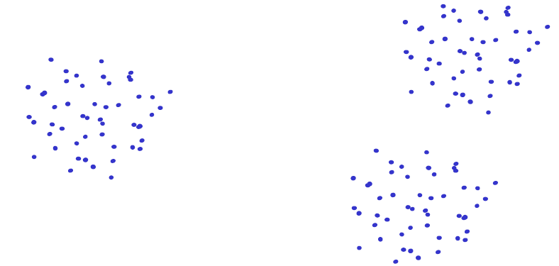
Strength and weakness of K-Means Method
Sensitivity to initial condition: K-means is sensitive to initial conditions. The algorithm randomly initializes the cluster centroids at the beginning, and the final clustering results can vary depending on these initial positions.
Different initializations can lead to other local optima, resulting in different clustering outcomes. This makes the K-means algorithm less reliable and reproducible.

Slide 27
Strength and weakness of K-Means Method
Dependent on initialization

Slide 28
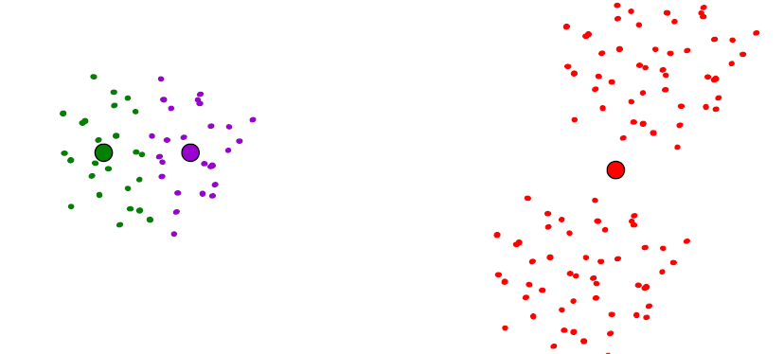
Strength and weakness of K-Means Method
Dependent on initialization

Slide 29
Strength and weakness of K-Means Method
Dependent on initialization
Select random seeds with at least D_{min}
Or, run the algorithm many times

Slide 30
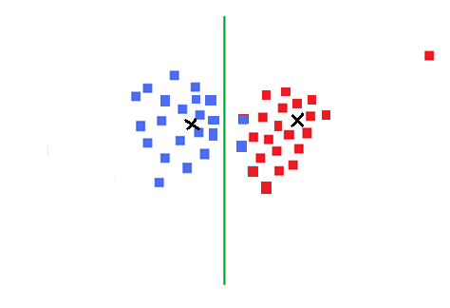
Strength and weakness of K-Means Method
Sensitive to outliers: K-means treats all data points equally and can be sensitive to outliers, which are unusual or extreme data points.
Outliers can distort the clustering process, causing the algorithm to create less reliable clusters.
Handling outliers
properly is important to get
better results.

Slide 31
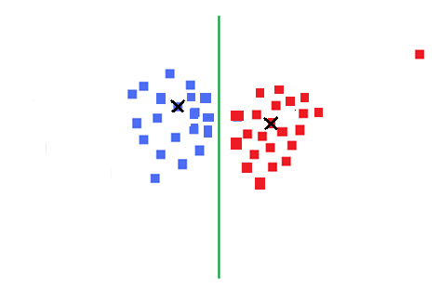
Strength and weakness of K-Means Method
Sensitive to outliers
Use K-medoids
(which is the most
centrally located
object in a cluster)
Notes:
Add definition of median

Slide 32
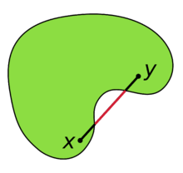
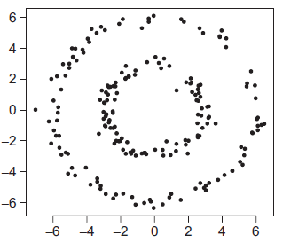
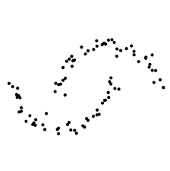
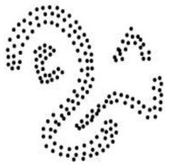
Strength and weakness of K-Means Method
Not suitable to discover clusters with non-convex shapes
K-means assumes that clusters are round or
spherical in shape. However, in real-world data,
clusters can have different shapes.
K-means may struggle to handle such irregular
clusters, resulting in less accurate clusters.
Other algorithms like DBSCAN or Gaussian Mixture Models can handle more complex cluster shapes.

Slide 33
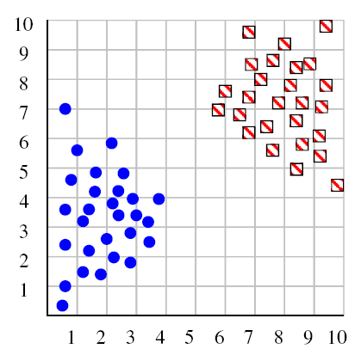
Strength and weakness of K-Means Method
Deciding K : With K-means, we have
to tell the algorithm how many clusters
we expect in the data.
This can be tricky, especially if we
don’t have prior knowledge about the
data.
Choosing the wrong number of clusters can lead to misleading results.
Methods like the elbow finding or silhouette analysis can help estimate the appropriate number of clusters, but it’s still a challenge.

Slide 34
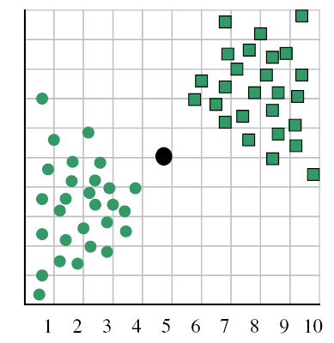
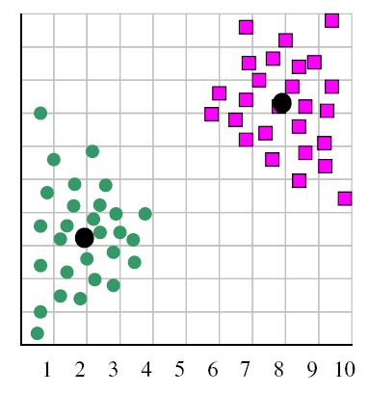
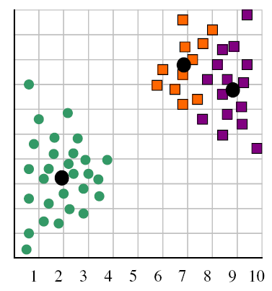
Deciding K
When k = 1, the
objective function is
873.0
When k = 2, the
objective function is
173.1
When k = 3, the objective function is 133.6

Slide 35
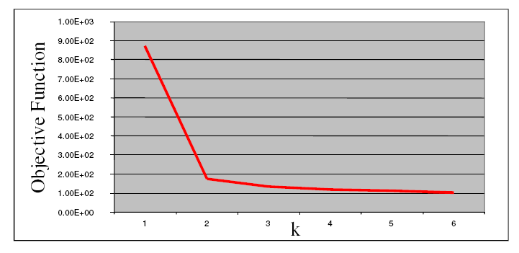
Deciding K
We can plot objective function values for k=1 to 6
The abrupt change at k=2 is highly suggestive of two clusters
Known as “knee finding” or “elbow finding”
Note that the results are not always as clear cut as in this toy example

Slide 36
Cluster Analysis
Cluster Analysis: Basic Concepts
Partitioning Methods
Hierarchical Methods
Density-Based Methods
Evaluation of Clustering
Summary
36
36
Notes:
36

Slide 37
Hierarchical clustering
Agglomerative (Bottom-up)
This bottom-up strategy starts by placing each object in its own cluster
Merge the two most similar clusters into one
Replace the two clusters into the new cluster
Re-compute intercluster similarity scores w.r.t. the new cluster
Repeat the above step until there are k clusters left (k can be 1)
Most hierarchical clustering methods belong to this category. They differ only in their definition of intercluster similarity.

Slide 38
Agglomerative clustering
Agglomerative (Bottom up)

Slide 39
Hierarchical clustering
Agglomerative (Bottom up)
1st iteration
1

Slide 40
Hierarchical clustering
Agglomerative (Bottom up)
2nd iteration
1
2

Slide 41
Hierarchical clustering
Agglomerative (Bottom up)
3rd iteration
3
1
2

Slide 42
Hierarchical clustering
Agglomerative (Bottom up)
4th iteration
3
1
2
4

Slide 43
Hierarchical clustering
Agglomerative (Bottom up)
5th iteration
3
1
2
5
4

Slide 44
Hierarchical clustering
Agglomerative (Bottom up)
Finally k clusters left
3
9
6
1
2
5
8
4
7

Slide 45


Intercluster similarity (δ)
The single linkage distance is the closest distance between two objects belonging to two different clusters.
The complete linkage distance represents the distance between the most remote objects belonging to two different clusters.
The average linkage distance defines the average distance between all the objects belonging to two different clusters.

Slide 46


Intercluster similarity (δ)
(4) The centroid linkage distance reflects the distance between the centers v_{s} and v_{t} of two clusters S and T respectively, defined as , where
(5) The average of centroids linkage represents the distance between the center of a cluster and all the objects belonging to a different cluster.

Slide 47
Time Complexity of Agglomerative Clustering
The time complexity of agglomerative clustering can vary depending on the chosen linkage criterion (e.g., single linkage, complete linkage, average linkage, etc).
Here's a general overview of the time complexity:
(i) Computing Pairwise Distances
Initially, we need to compute the pairwise distances between all data points.
This step typically requires operations if we are using a simple distance metric like Euclidean distance, where d is the dimension of the object. More complex distance metrics may have higher time complexity.

Slide 48
Time Complexity of Agglomerative Clustering
(ii) Cluster Merging
At each iteration, we need to identify the closest pair of clusters and merge them.
Identifying the closest pair of clusters can be done efficiently using data structures like priority queues or minimum spanning trees.
Merging generally requires operations if we use a brute-force approach to compare all pairs of clusters.
Thus, the merging process requires O(n²) operations (to find the closest clusters) at each step, over (n−1) merges.
Thus, the overall time complexity for agglomerative clustering is: O(n³)

Slide 49
Divisive clustering
Divisive (Top-down)
Start at the top with all objects in one cluster
The cluster is split into subclusters using a flat clustering algorithm
This procedure is applied recursively until each object is in its own singleton cluster or
until it satisfies certain termination conditions, such as (i) a desired number of clusters is obtained or (ii) the distance between the two closest clusters is above a certain threshold distance.

Slide 50
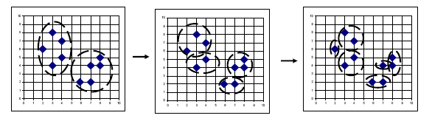
Hierarchical clustering
Divisive (Top-down): Use flat clustering say, K-Means clustering with K=2.

Slide 51
Time Complexity
Divisive clustering is the opposite of agglomerative clustering, where we start with a single cluster containing all data points and recursively split it into smaller clusters.
The time complexity of divisive clustering depends on the specific algorithm used for splitting clusters and the criteria for determining the optimal splits.
Some divisive clustering algorithms may have exponential time complexity in the worst-case scenario, particularly if they exhaustively search for the best splits.
It's important to note that these complexities are theoretical and can vary in practice based on the implementation details, optimizations, and characteristics of the dataset.
Additionally, the time complexity may also be influenced by factors such as the dimensionality of the data and the choice of distance metric.

Slide 52
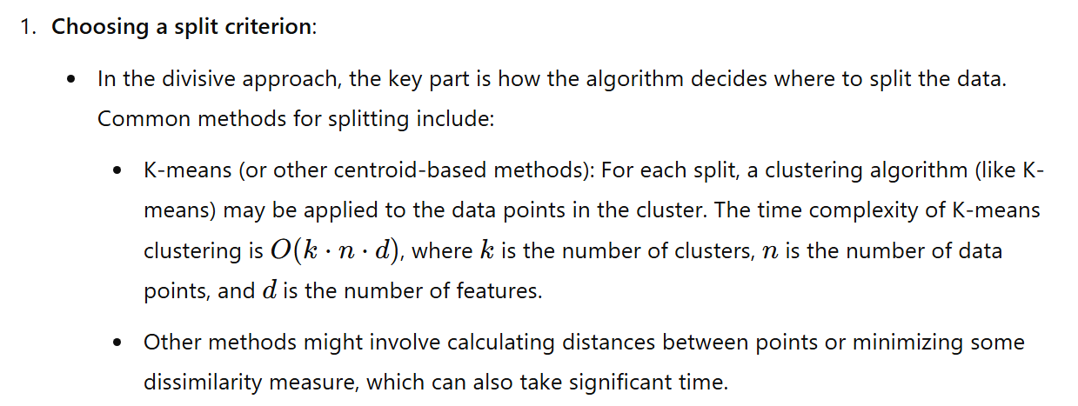
Time Complexity

Slide 53
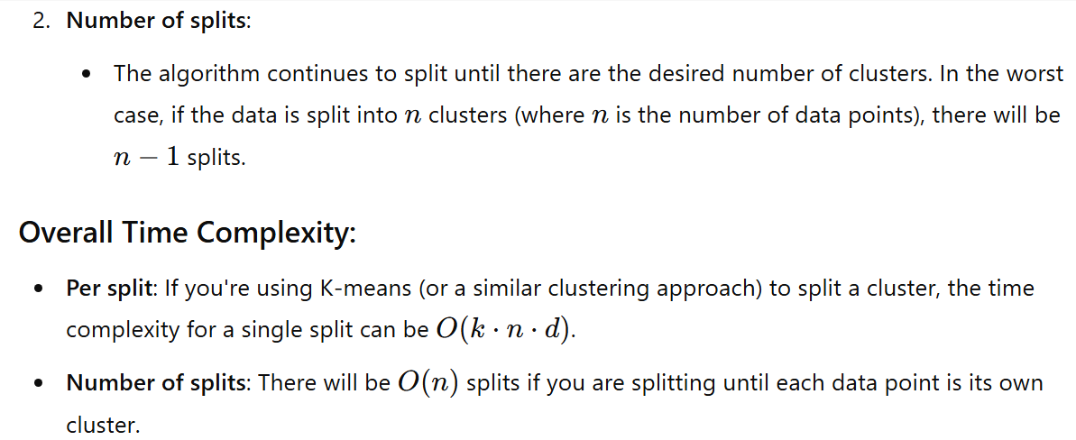
Time Complexity

Slide 54
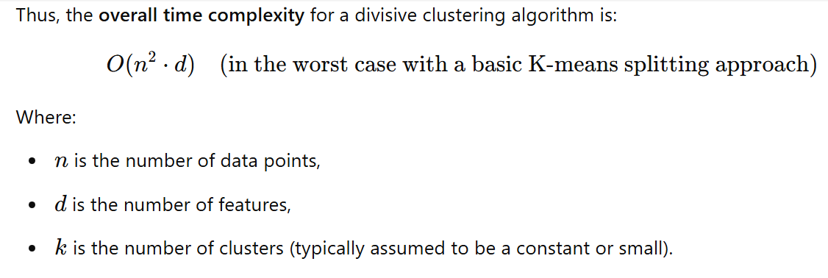
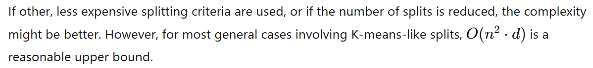
Time Complexity

Slide 55
Bottom-up vs. Top-down
Which one is more complex?
Which one is more efficient?
Which one is more accurate?

Slide 56
Bottom-up vs. Top-down
Which one is more complex?
Top-down
Because a flat clustering is needed as a “subroutine”
Which one is more efficient?
Which one is more accurate?

Slide 57
Bottom-up vs. Top-down
Which one is more complex?
Which one is more efficient?
Which one is more accurate?

Slide 58
Bottom-up vs. Top-down
Which one is more complex?
Which one is more efficient?
Top-down
For a fixed number of top levels, using an efficient flat algorithm like K-means, divisive algorithms time complexity are O(n²), approximately
Agglomerative algorithms time complexity are O(n³), approximately

Slide 59
Bottom-up vs. Top-down
Which one is more complex?
Which one is more efficient?
Which one is more accurate?

Slide 60
Bottom-up vs. Top-down
Which one is more complex?
Which one is more efficient?
Which one is more accurate?
Top-down
Bottom-up methods make clustering decisions based on local patterns without initially taking into account the global distribution. These early decisions cannot be undone.
Top-down clustering benefits from complete information about the global distribution when making top-level partitioning decisions.

Slide 61


